Slide 1
FACE EMOTION BASED MUSIC PLAYER
PROJECT GUIDE
Dr. K. SRINIVASAN,
Assistant Professor & Head of the Department,
Department Of Computer Science,
Govt.Art’s And Science College,
Pennagaram.
STUDENT NAME
VENKATESH . R
C21PG171CSC021
II M.Sc.(CS)
Dept. of Computer Science
Govt.Art’s And Science College,
Pennagaram

Slide 2
CONTENTS
Synopsis
Introduction
Exiting System
Proposed System
Module Description
Block Diagram
Testing
Source Code
Input / Output
Final Result
Conclusion
Feature Enhancement

Slide 3
SYNOPSIS
The Face Emotions Based Music Player is an artificial intelligence-based music player that uses facial recognition technology to detect human emotions and match the user's current emotional state with an appropriate song. By analyzing the user's facial expressions, the AI-based Music Player can interpret their emotional state and then provide a personalized list of tracks tailored to the individual’s emotion.

Slide 4
INTRODUCTION
Introducing a face emotion-based music player! This innovative music player uses facial recognition technology to detect the user's emotions and plays music that matches their mood.
The concept is simple: the music player uses the camera on the user's device to capture their facial expressions and then analyzes the data to determine their emotional state. Based on this information, the music player selects and plays songs that match the user's current mood.

Slide 5
SYSTEM SPECIFICATION
HARDWARE SPECIFICATION :
System : Lenovo E41-25 Notebook
Hard Disk : 500 GB
Processor : 2.00 GHz
RAM : 4.00GB
System type : 64 bit (operating system )

Slide 6
SOFTWARE SPECIFICATION:
Operating system : Windows 10
Code Language : Python and Javascript
IDE : Pycharm
Front End : Html and css
Back End : JavaScript and Python

Slide 7
EXISTING SYSTEM
Spotify :
Moodfuse :
YouTube Music :

Slide 8
DISADVANTAGES
Limited mood regulation
Limited engagement
Potential for mental health issues
Limited discovery
Repetitiveness

Slide 9
PROPOSED SYSTEM
The primary goal of an emotion-based music player is to provide user- preferred music with emotion identification by automatically playing songs based on the user’s feelings.
In the current system, the user must manually choose the tunes because songs generated at random may not suit the user’s mood.
The music will be played from the predetermined folders in accordance with the emotion detected.

Slide 10
PROPOSED SYSTEM
ADVANTAGES:
Discovery of new music
Time-saving
Convenient
Engagement
Personalized experience

Slide 11
MODULE DESCRIPTION
This project is divided into five modules. They are
Face Detection Module ✓
Emotion Recognition Module ✓
Music recommendation module ✓
Music playback module ✓
User feedback module

Slide 12
1. Face detection module:
This module would be responsible for detecting the user's face and locating the key facial features necessary for emotion recognition.
2. Emotion recognition module:
This module would use machine learning algorithms to analyze the user's facial expressions and determine their emotional state. This could be done using facial landmarks, such as the position of the eyebrows, mouth, and eyes.

Slide 13
3. Music recommendation module:
Once the user's emotional state has been determined, this module would suggest music that is likely to fit their mood. This could be done by analyzing the tempo, rhythm, and tone of different songs and selecting the most appropriate ones.
4. Music playback module:
This module would be responsible for playing the selected music, adjusting the volume and other playback settings as needed.
5. User feedback module:
Finally, this module would allow the user to provide feedback on the music selection and adjust the system's recommendations over time based on their preferences.

Slide 14
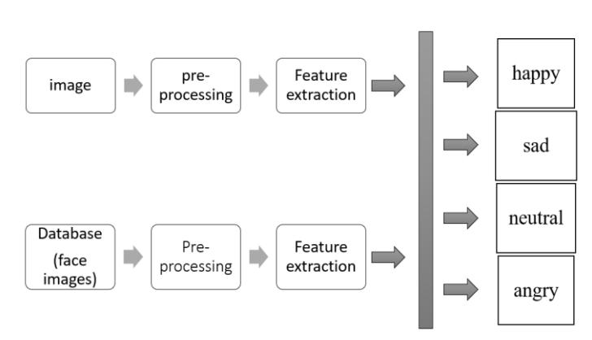
SYSTEM FLOW DIAGRAM

Slide 15
TESTING
UNIT TESTING
It focuses on the smallest unit of software design. In this, we test an individual unit or group of interrelated units.
It is often done by the programmer by using sample input and observing its corresponding outputs.
def getEmotion(): face_classifier=cv2.CascadeClassifier('./keras/haarcascade_frontalface_default.xml')
classifier =load_model('./keras/Emotion_Detection.h5')
class_labels = ['angry','happy','neutral','sad','Surprise']
cap = cv2.VideoCapture(0)
while True:
label="" # Grab a single frame of video ret,
frame = cap.read() labels = []
gray = cv2.cvtColor(frame,cv2.COLOR_BGR2GRAY)
faces = face_classifier.detectMultiScale(gray,1.3,5)

Slide 16
VALIDATION TESTING
User Acceptance Testing is a critical phase of any project and requires significant participation by the end user.
if(!songrun){
var z=songs[x][0]; document.getElementById("sname").innerHTML=sname[x]; document.getElementById("sel").src= z; document.getElementById("main_slider").load(); document.getElementById("main_slider").play();
document.getElementById("emoji").style.backgroundImage="url('"+songs[x][ 3]+"')";

Slide 17
SAMPLE CODING
<!DOCTYPE html> <html>
<head> <meta charset="UTF-8"> <title>E Music Player </title>
<script type="text/javascript" src="/eel.js"></script>
<link rel="stylesheet" type="text/css" href="header.css">
<link rel="stylesheet" type="text/css" href="background.css">
<link rel="stylesheet" type="text/css" href="player.css">
<style> body{ margin: 0; }</style>
<link rel="icon" type="image/png" href="./bg/i.png">
</head> <body> <br><br><br><br><br>
<div id="first"> <h1 font-family="verdana" align="center" style="font-size: 40px;color: white;margin: 0;">Venkey Music Player<h1> </div> 20
21 <script src="code.js"></script>

Slide 18
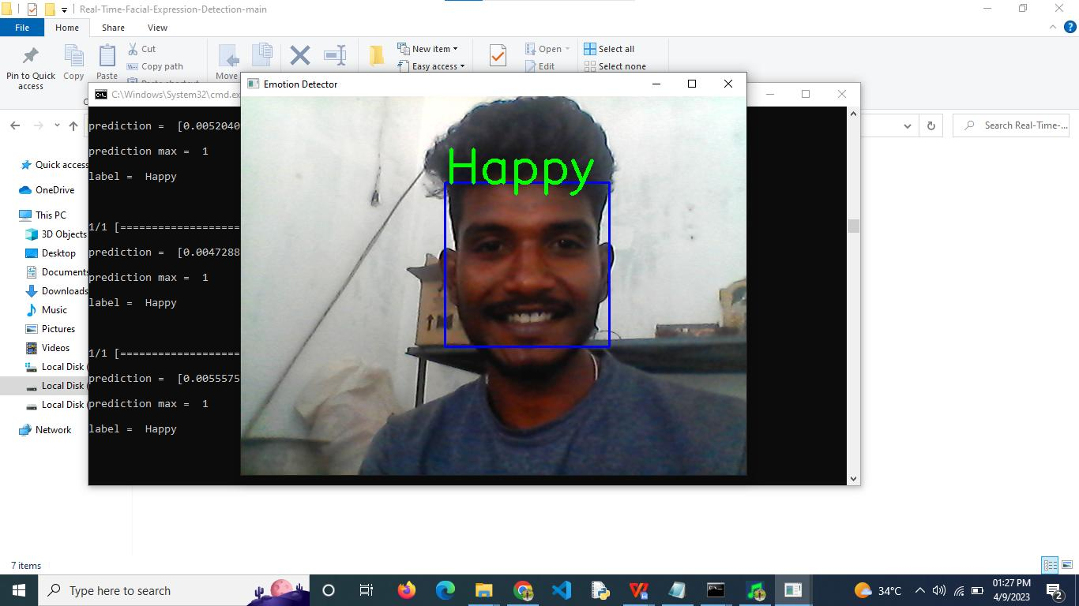
INPUT

Slide 19
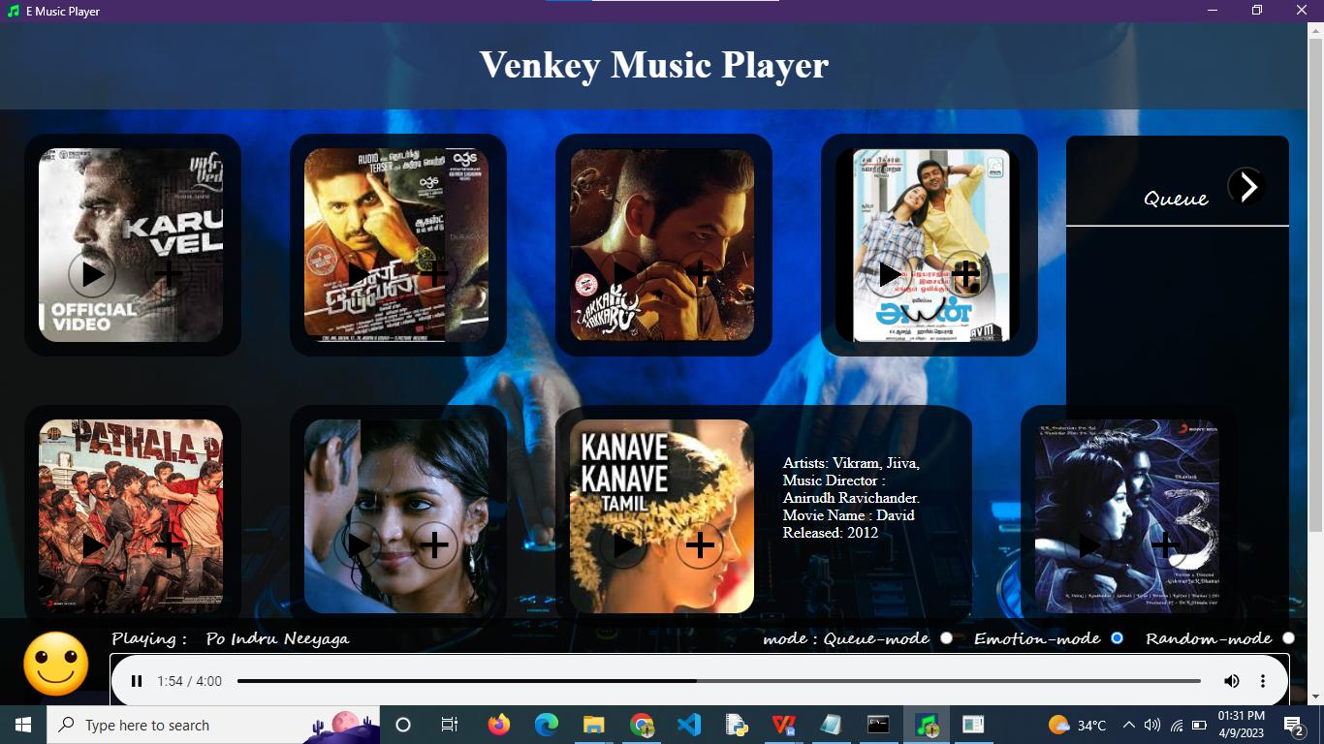
INPUT

Slide 20
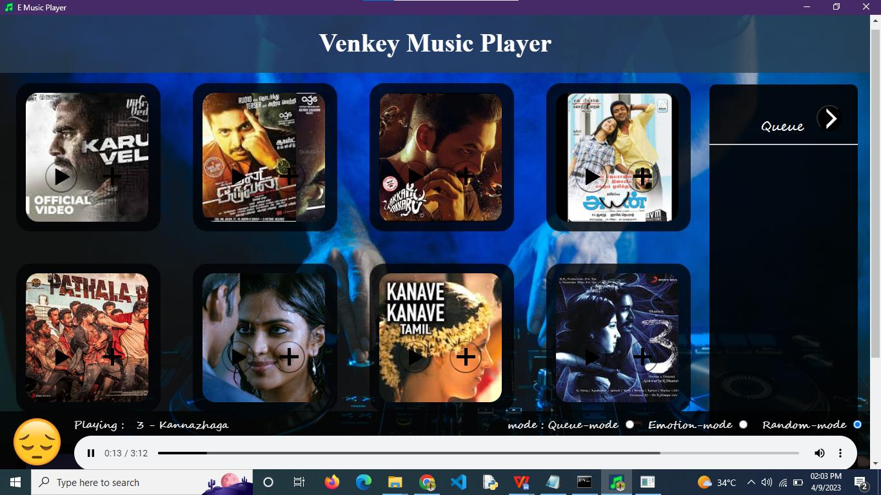
OUTPUT

Slide 21
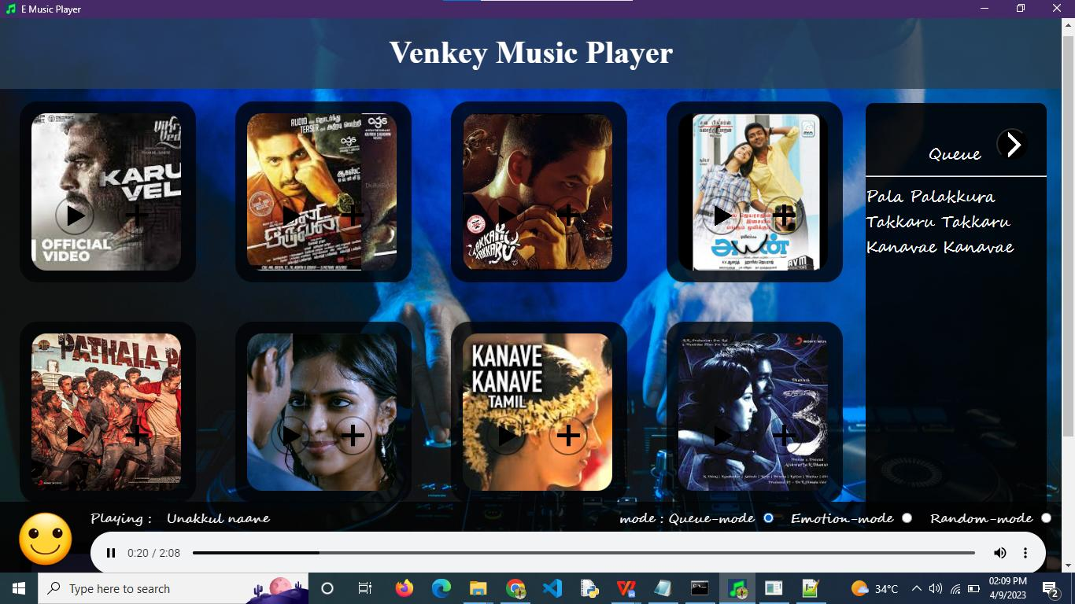
OUTPUT

Slide 22
Conclusion
The Emotion based music player has been developed.
The music player provides custom playlist of music according to users emotion by real-time analysis of the Facial emotion ex- pressed and according to the emotion the playlist is generated.
There are four moods deployed that is Happy, Sad, Neutral, Angry. When the user clicks on the emoji, the song will be played.

Slide 23
FEATURE ENHANCEMENT
Songs can be exported to a cloud database so that customers can download whatever song they desire because mobile applications have a finite amount of memory.
When we can only use cloud storage for additional memory needs, it is not practical to store a tonne of music inside an app.
Analyzing the song lyrics and estimate the emotion of the song and combine the emotion with the emotion of the song.
Including voice input for faster emotion recognition.

Slide 24
Thank you!!

